Slide 1

Software Engineering Internship
Srikar Kotra

Slide 2











Agenda
Introduction
"The first rule of any technology used in a business is that automation applied to an efficient operation will magnify the efficiency.“ — Bill Gates
Enhancing Cloud Operations
Cost Optimization
Impact
Journey and Roadmap

Slide 3


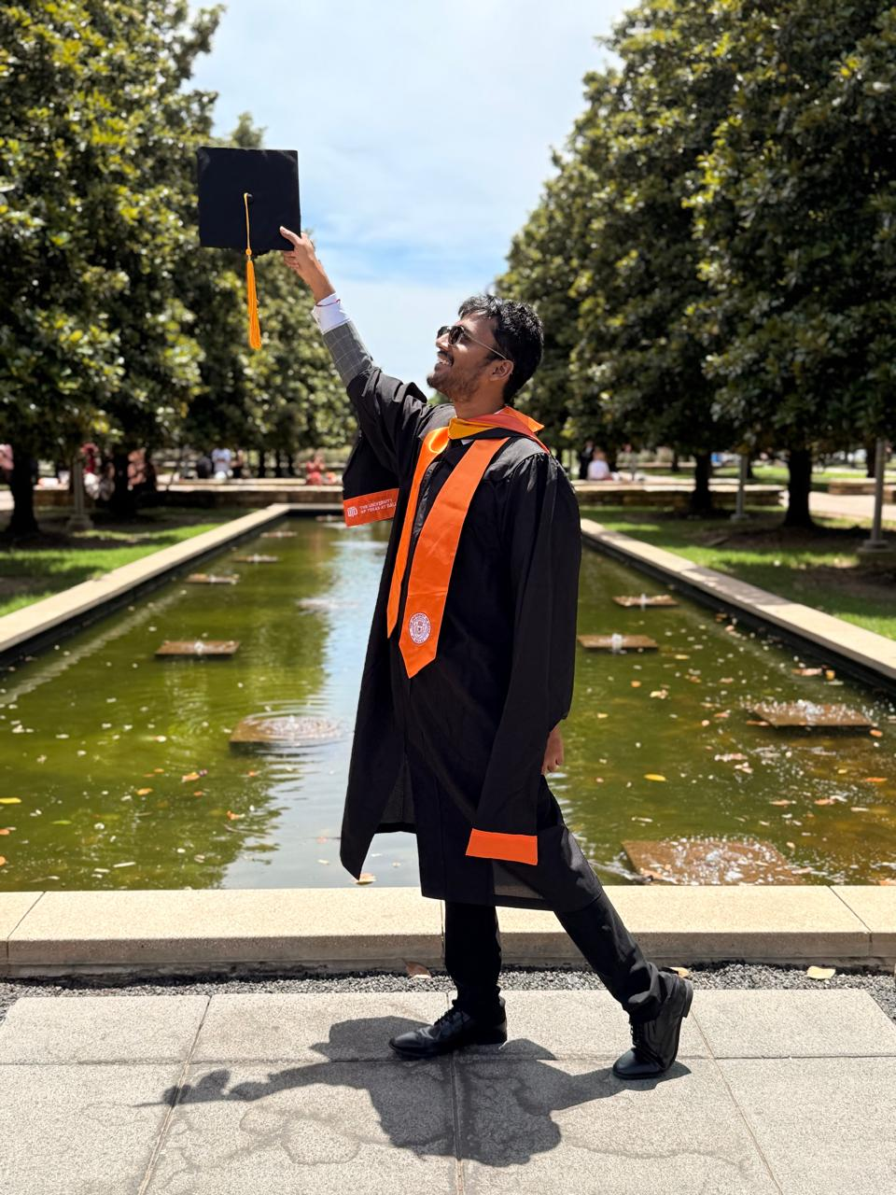
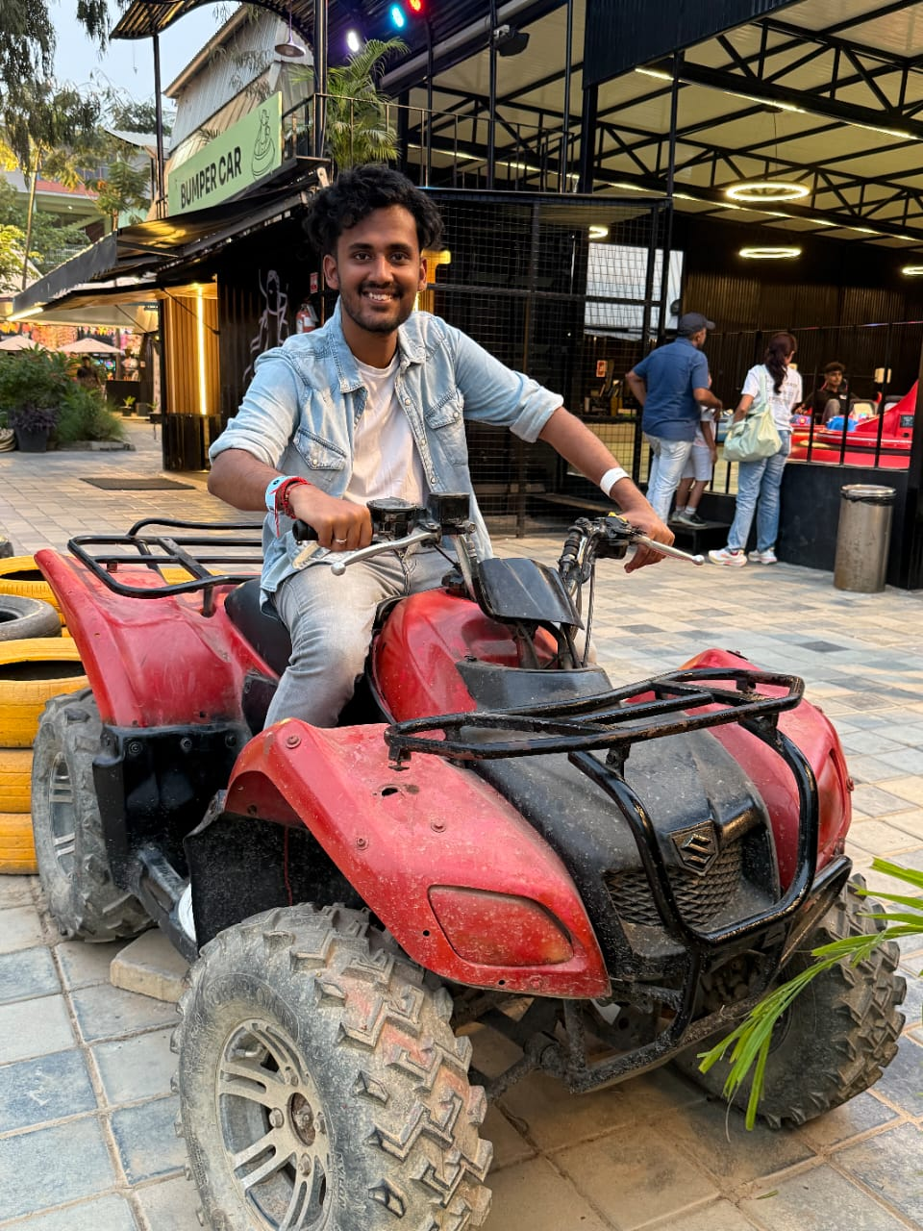
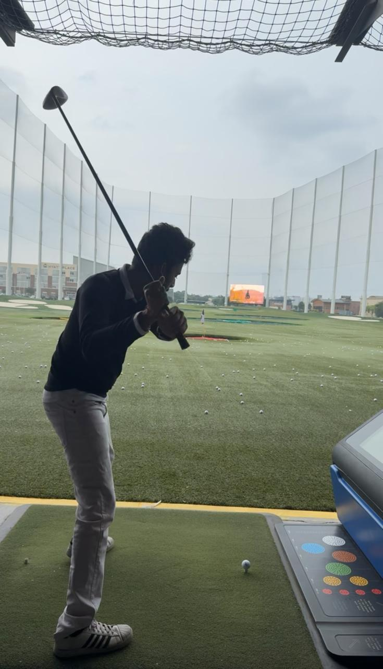
About Me
1
Name: Srikar Kotra
Title: Software Engineering Intern
Manager: John Gideon
Mentor: Thilak Jayachandran
Team: Cloud Transformation
Education: University of Texas at Dallas (UTD)
Graduation: May 2025
Hometown: Dallas
Major: Computer Science
Hobbies: Soccer, Badminton, Travel
Notes:
So a little bit about me, My name is Chirag Godha and I am working under Phani on the DotCom Team. I am completing my bachelors in Computer and Data Science at Rutgers University in my hometown of New Jersey. And outside of work and school I love to play basketball, work towards my health goals and learn to cook new recipies. Now let jump into the projects

Slide 4
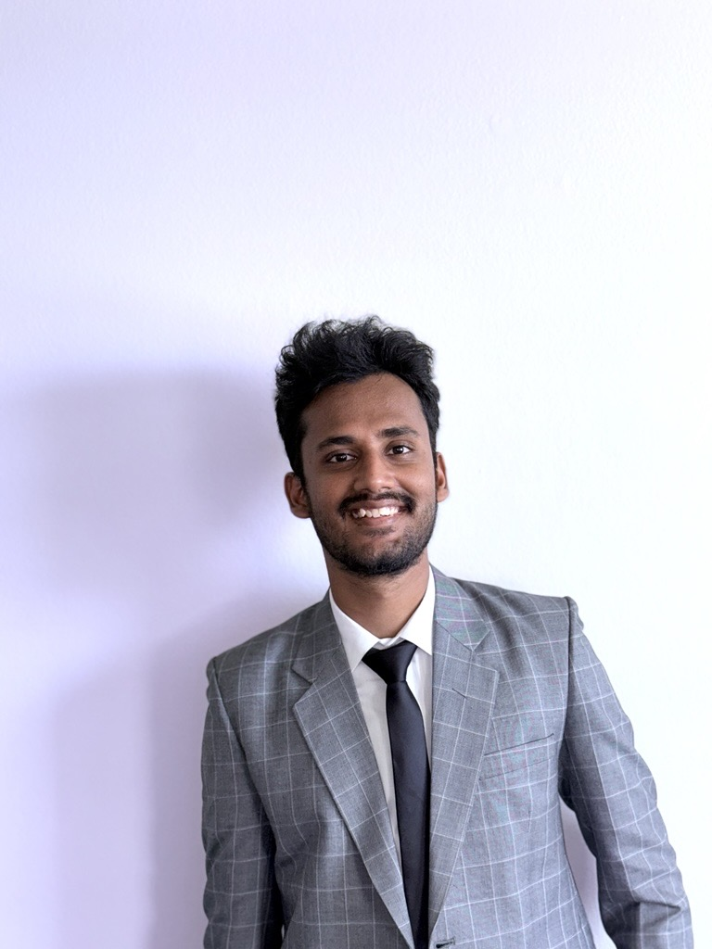

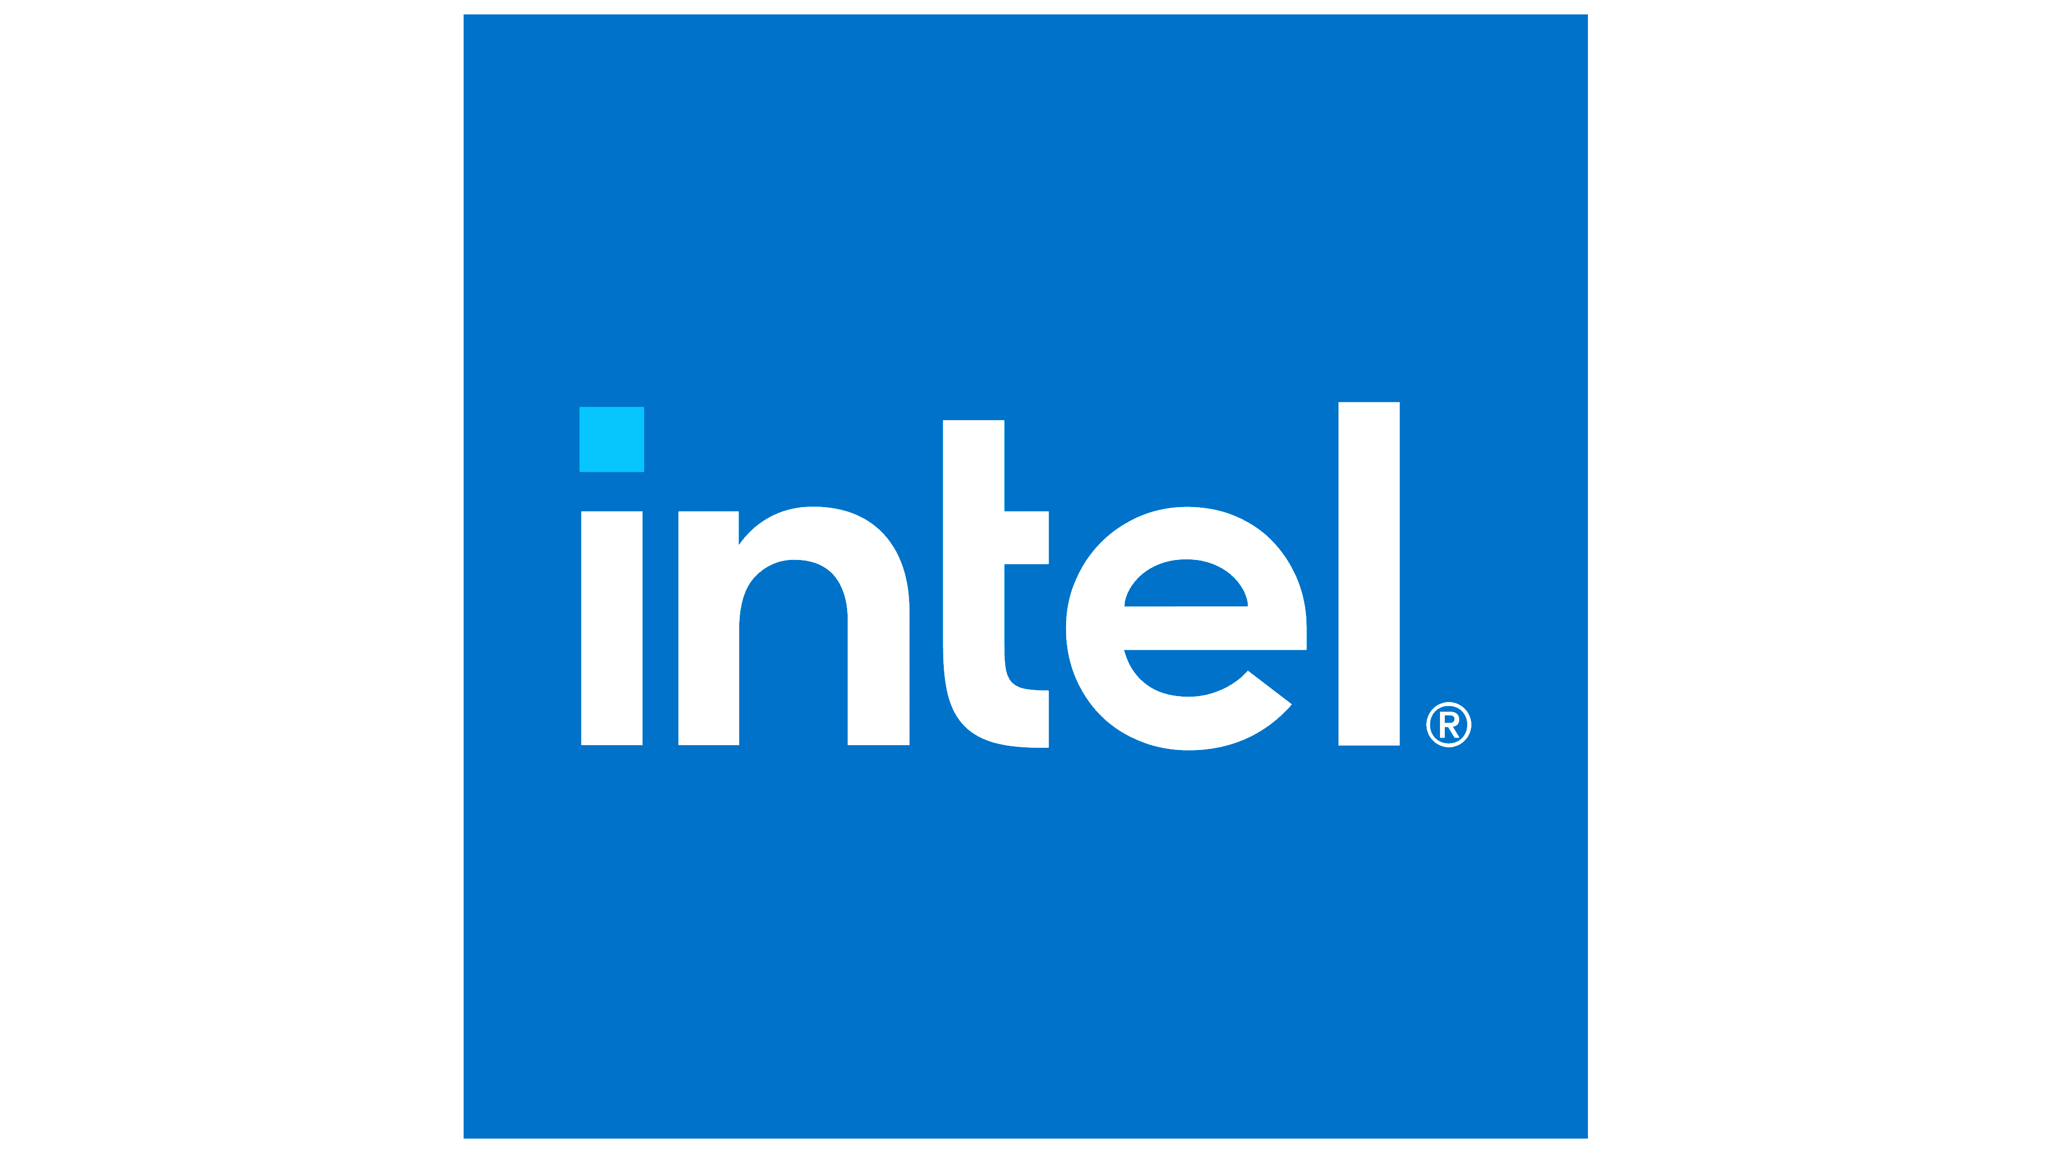
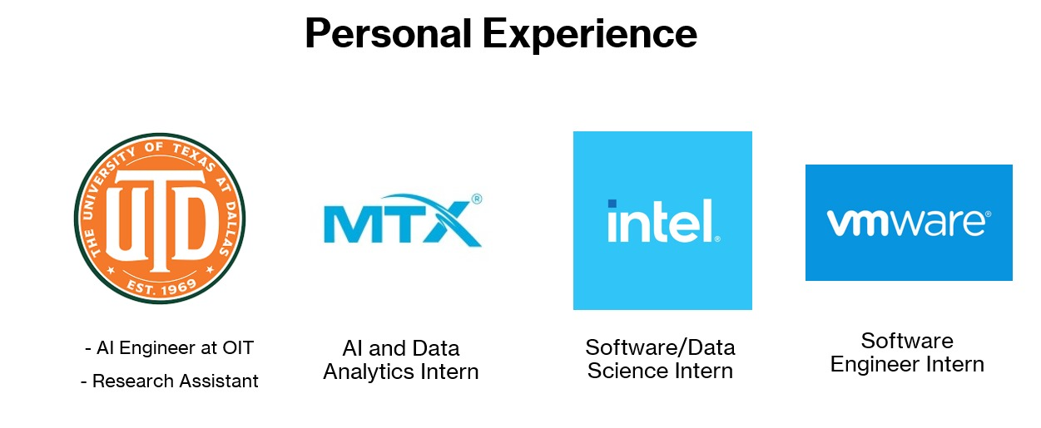
Experience
AI Engineer
AI and Data Analytics Intern
Software Engineer
Software Engineering Intern
2024- 2025
2022-2023
2024
2021
Notes:
So a little bit about me, My name is Chirag Godha and I am working under Phani on the DotCom Team. I am completing my bachelors in Computer and Data Science at Rutgers University in my hometown of New Jersey. And outside of work and school I love to play basketball, work towards my health goals and learn to cook new recipies. Now let jump into the projects

Slide 5



Projects Introduction
Cloud Transformation
Team
Your Intelligent Cloud Assistant
Agentic AI Cloud Rightsizing Agent
Agentic AI Anomaly Detection
Leverage SNOW ticket history insights to resolve issues efficiently.
Instantly search CBRE’s cloud knowledge base for fast, relevant answers.
AI-powered solution that continuously analyzes past 30 days of resource utilization across cloud assets.
Provides optimized right-sizing recommendations for cloud infrastructure.
Agentic AI powered solution that alerts anomalies to save costs
Provides optimized recommendations for cloud infrastructure around 4 cloud platforms
My Focus
Latency (Responses from 50s -> <6s)
LLM Observability
My Focus
Creating user schema, roles and privileges
My Focus
Solo project, started from scratch
Agentic Architecture
ML model for false alarms

Slide 6
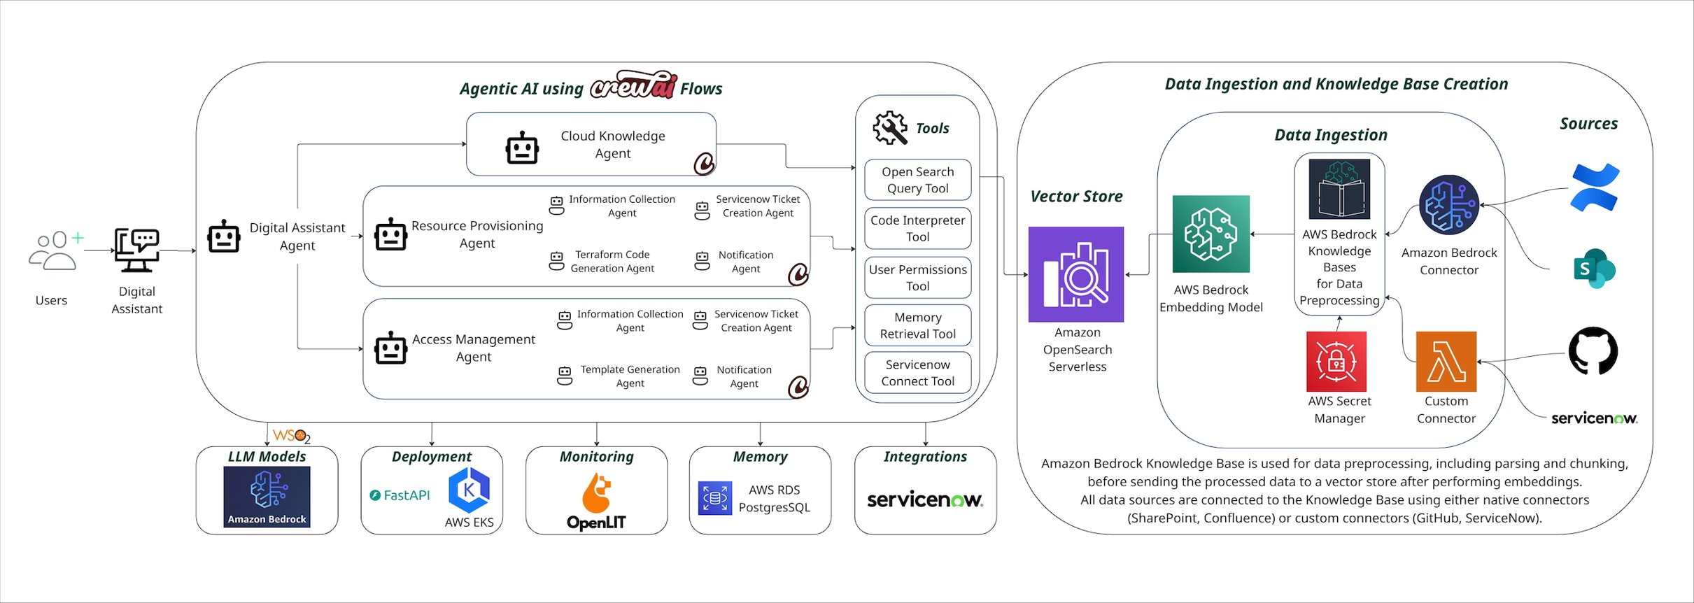



My Internship Focus
Optimizing Latency
LLM Observability Integration and Redaction
Observability
Monitoring
Logging
Tracing
Clustering
Redacting

Slide 7



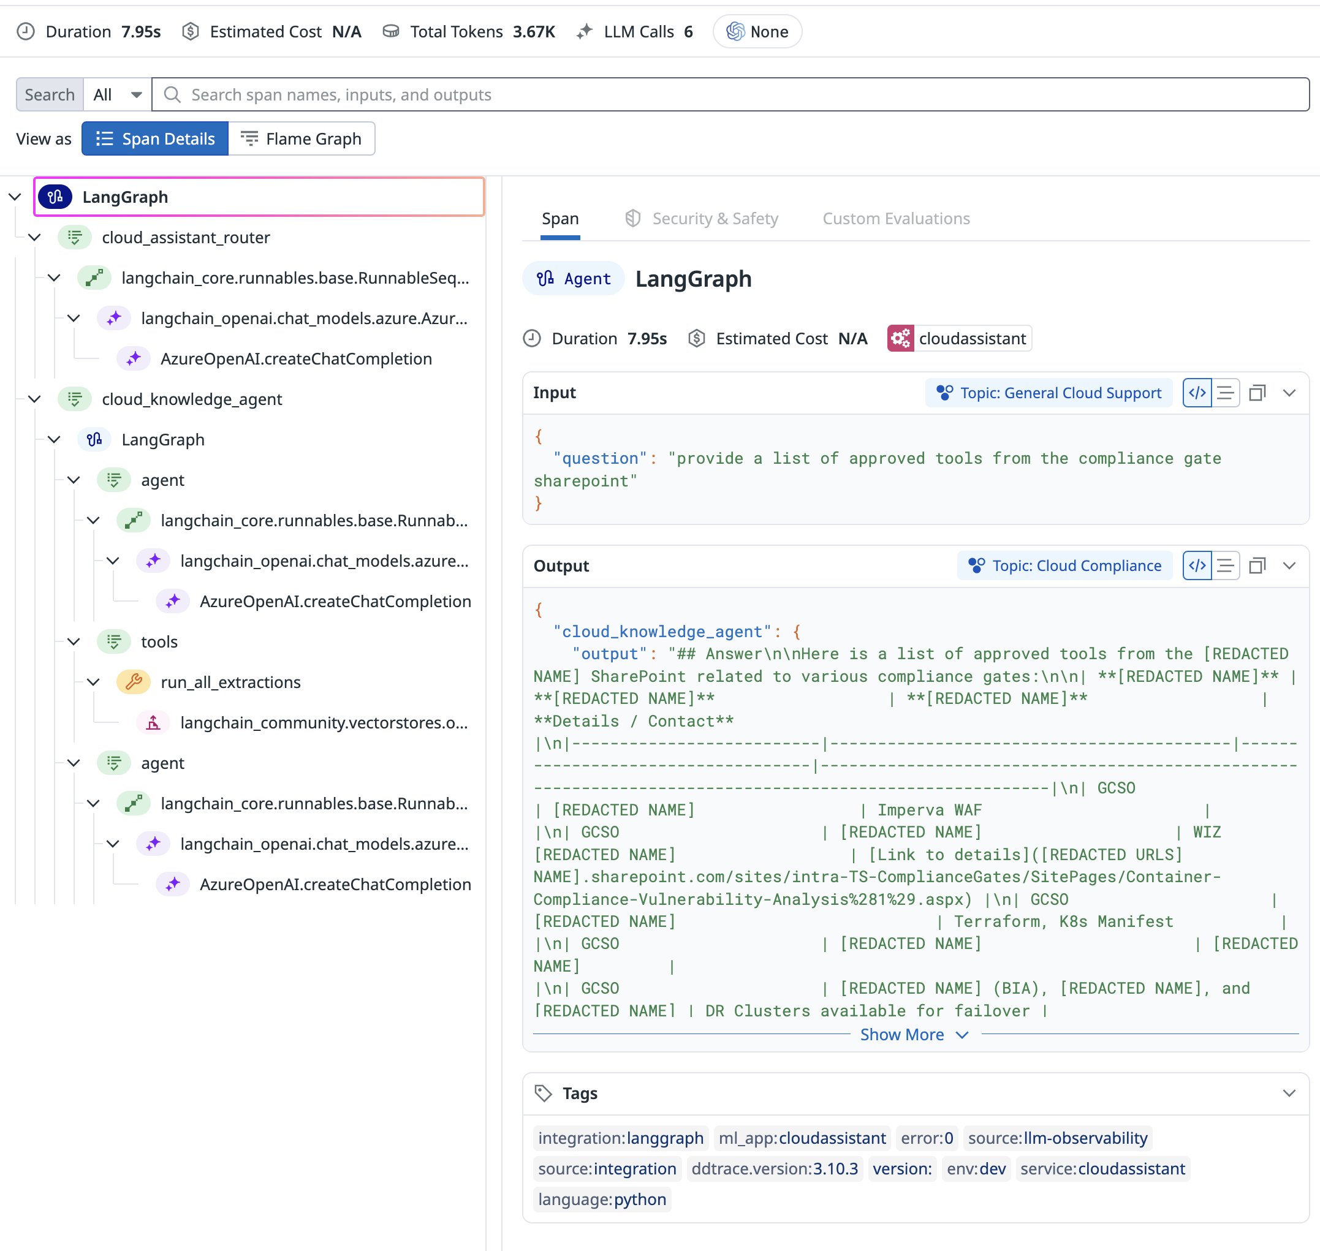
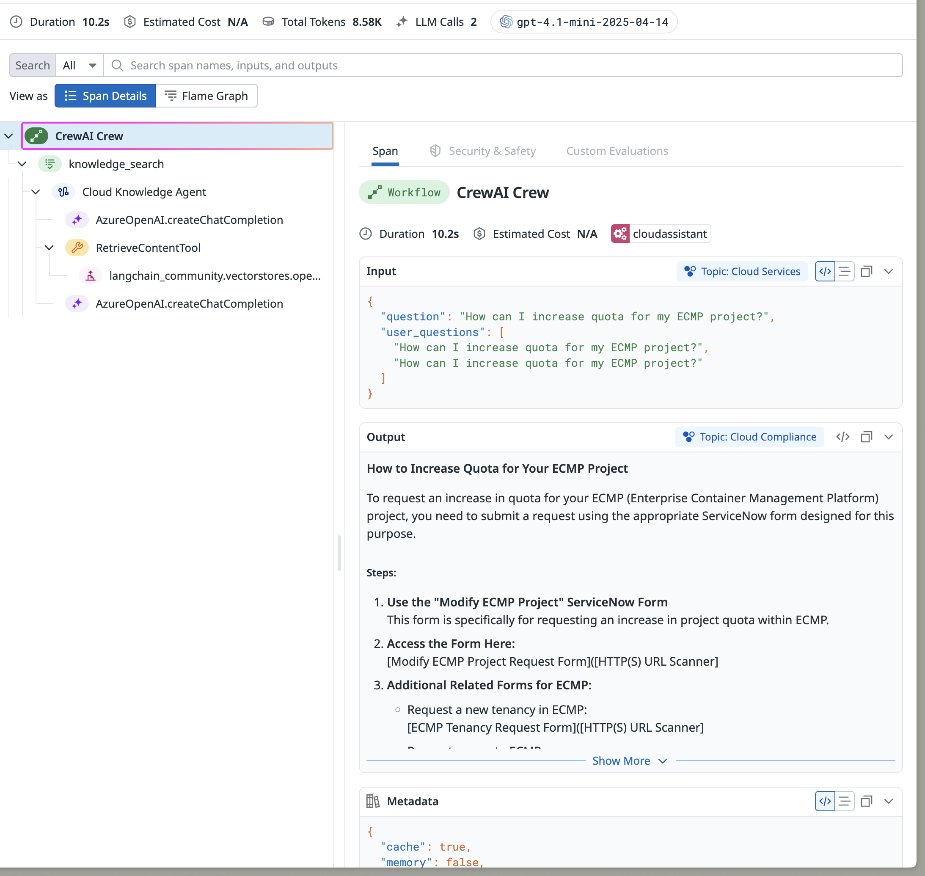



LLM Observability
LangGraph Span
CrewAI Span

Slide 8
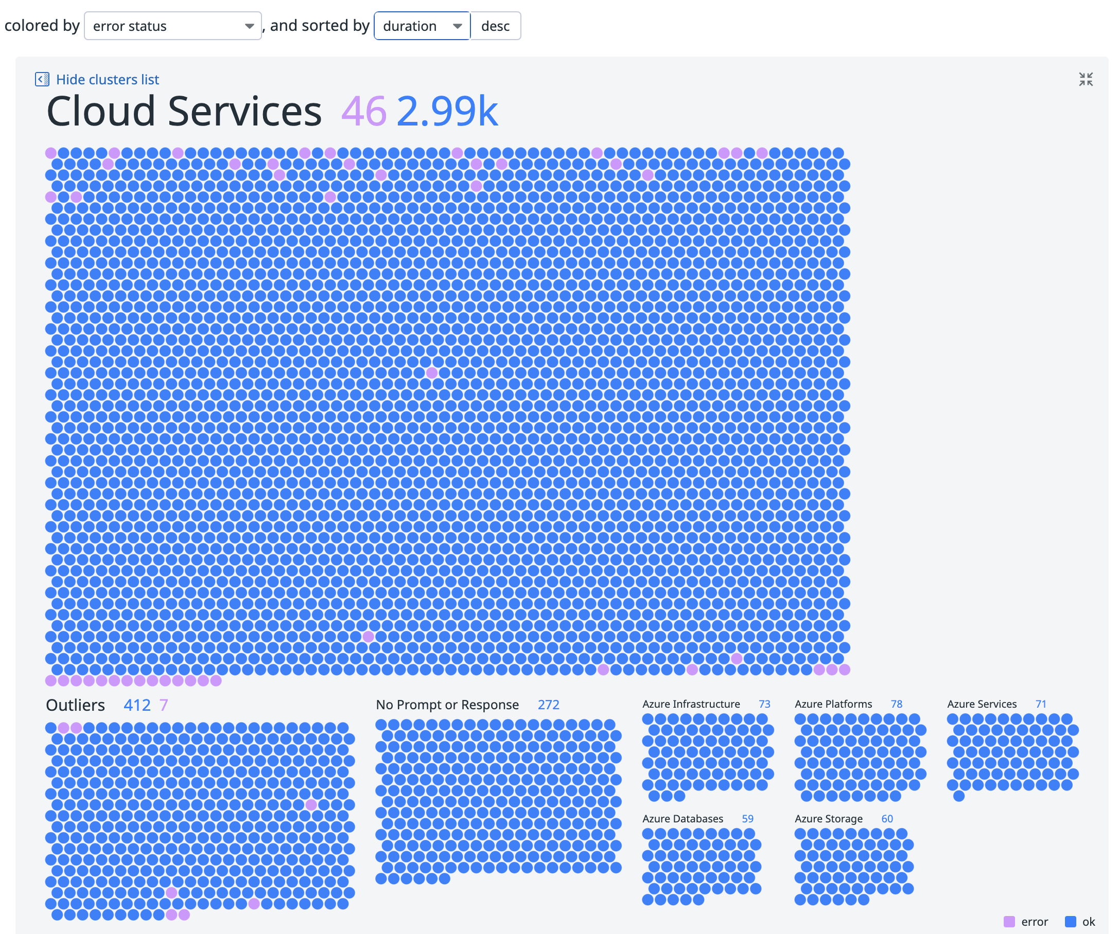
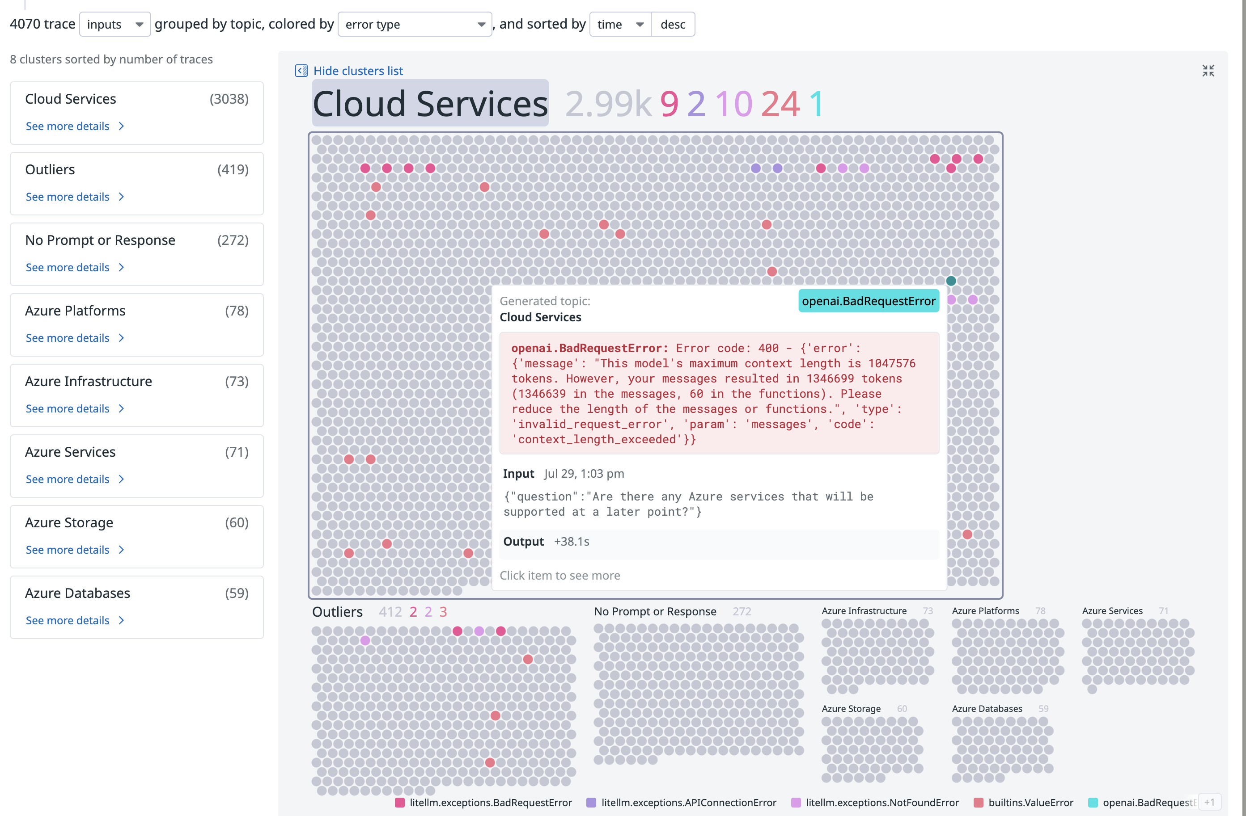
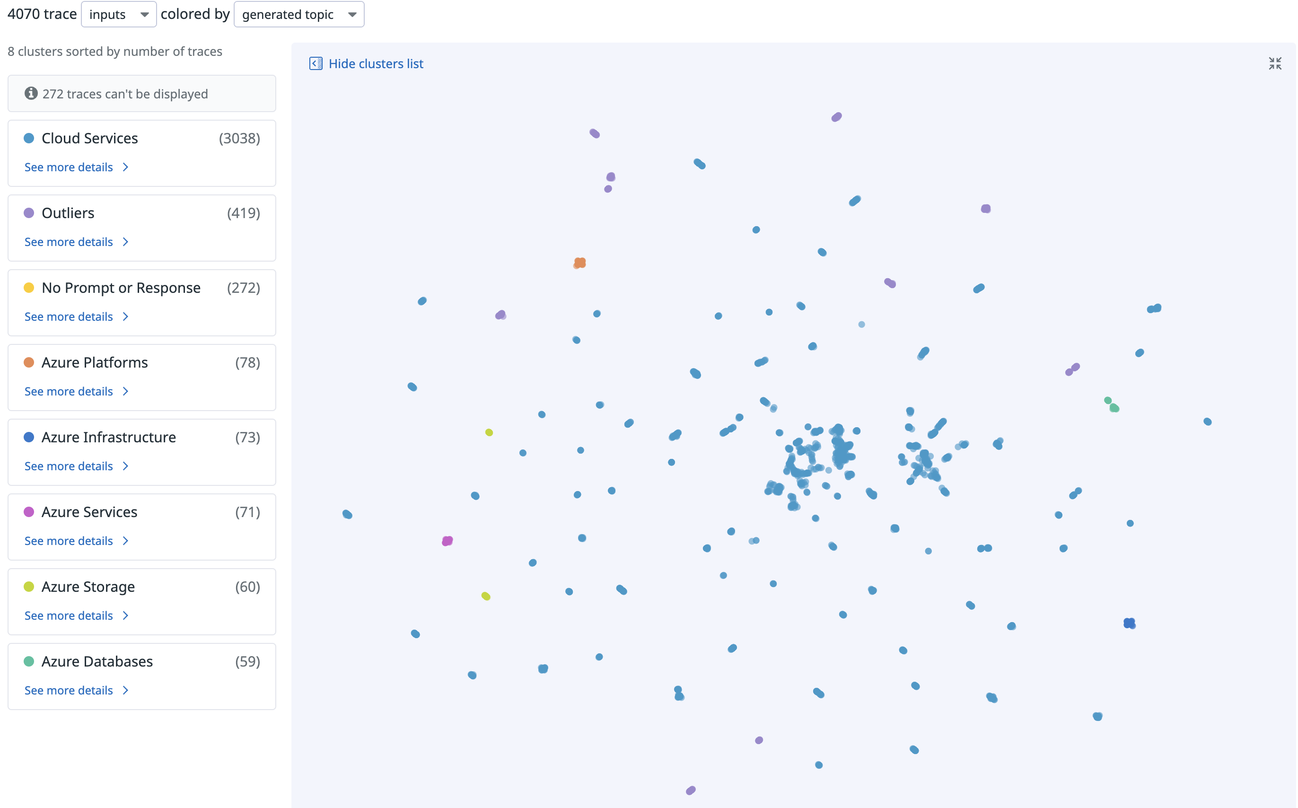
Datadog - Clustering /Scatterplot
4070 traces clustered

Slide 9
Datadog - Clustering /Scatterplot
Where can I find the most asked questions now?

Slide 10
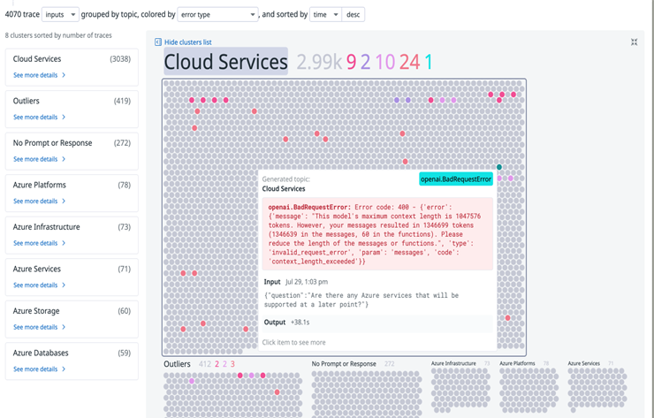
Datadog - Clustering /Scatterplot
Developer: Why did I get an error after almost 500 successful responses out of blue?
Note: Since traces are sorted by time, a line of same color shows that the error hasn’t been resolved.

Slide 11
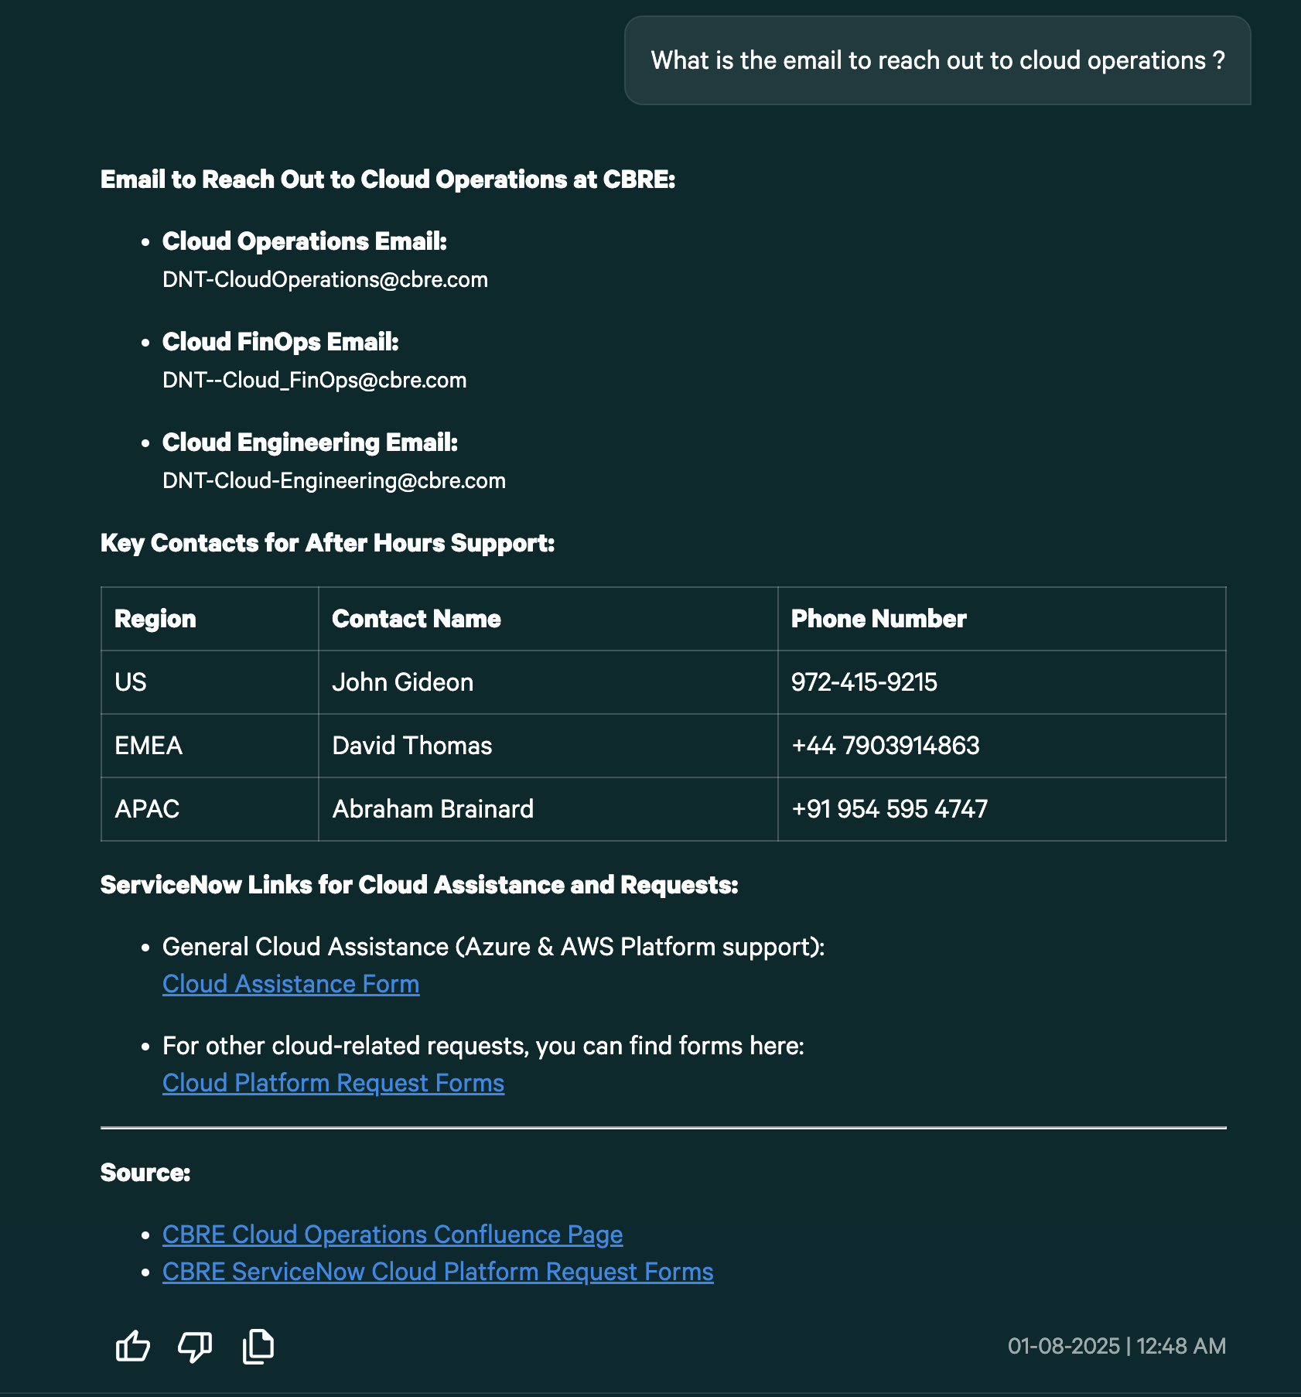
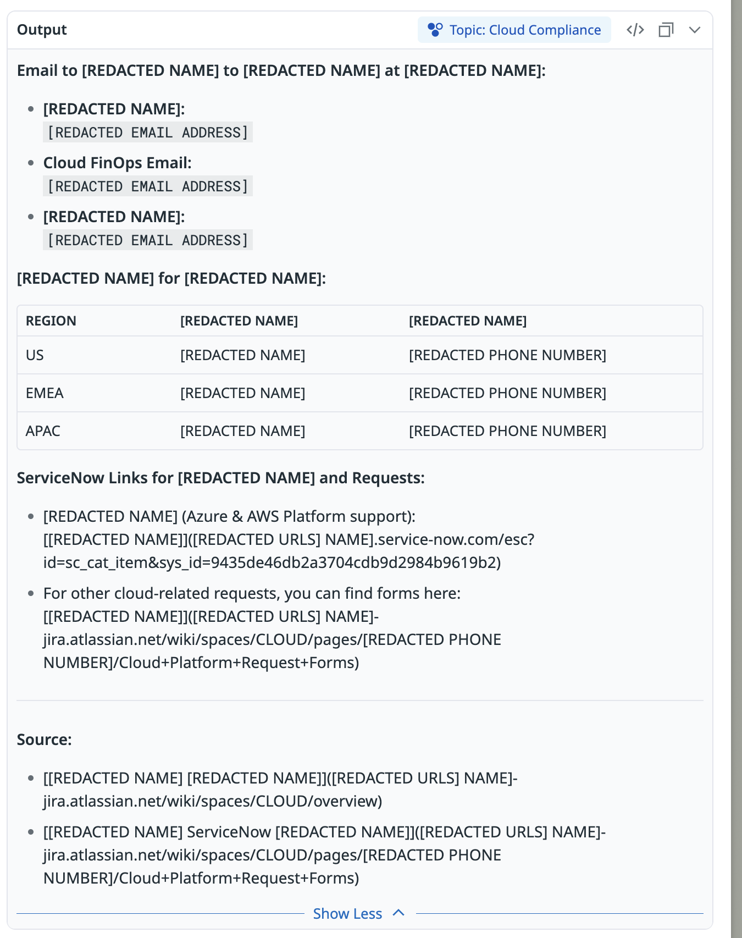
Redaction
Before Redaction
After Redaction

Slide 12
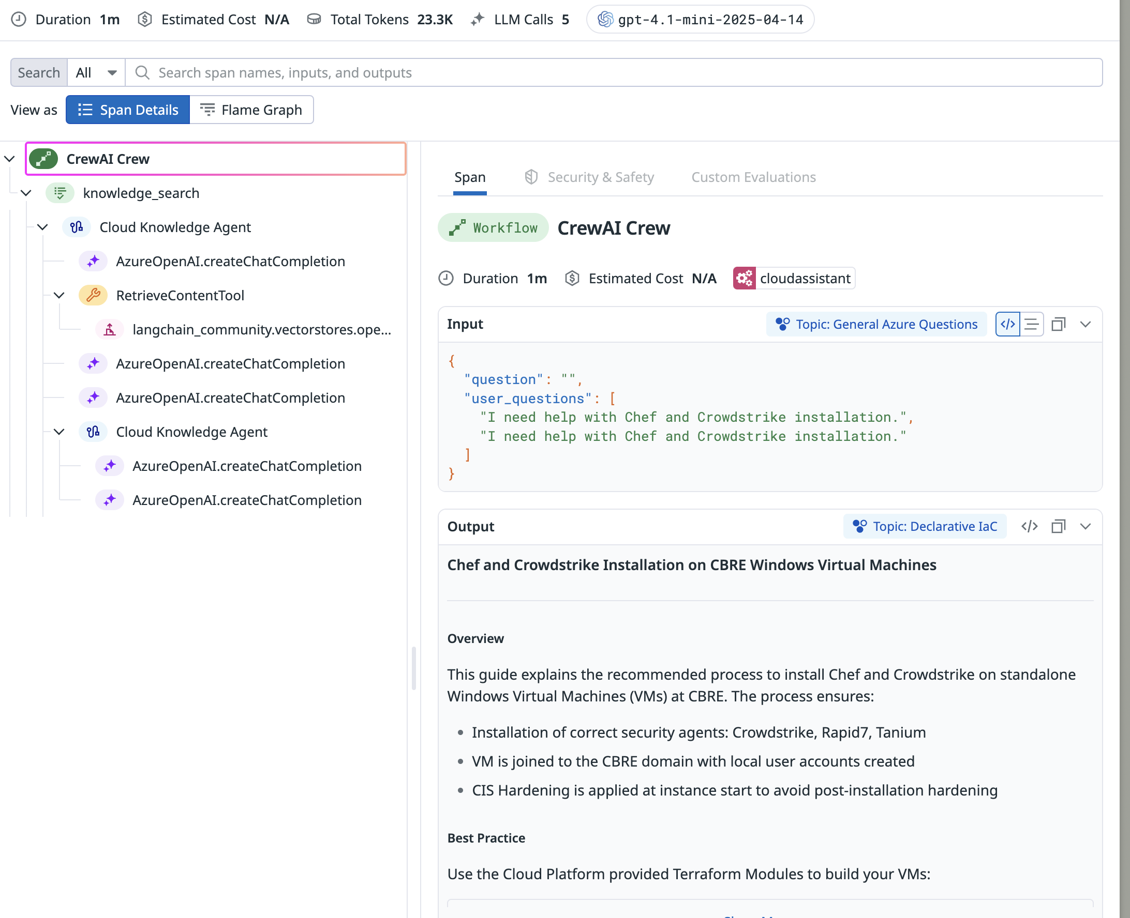
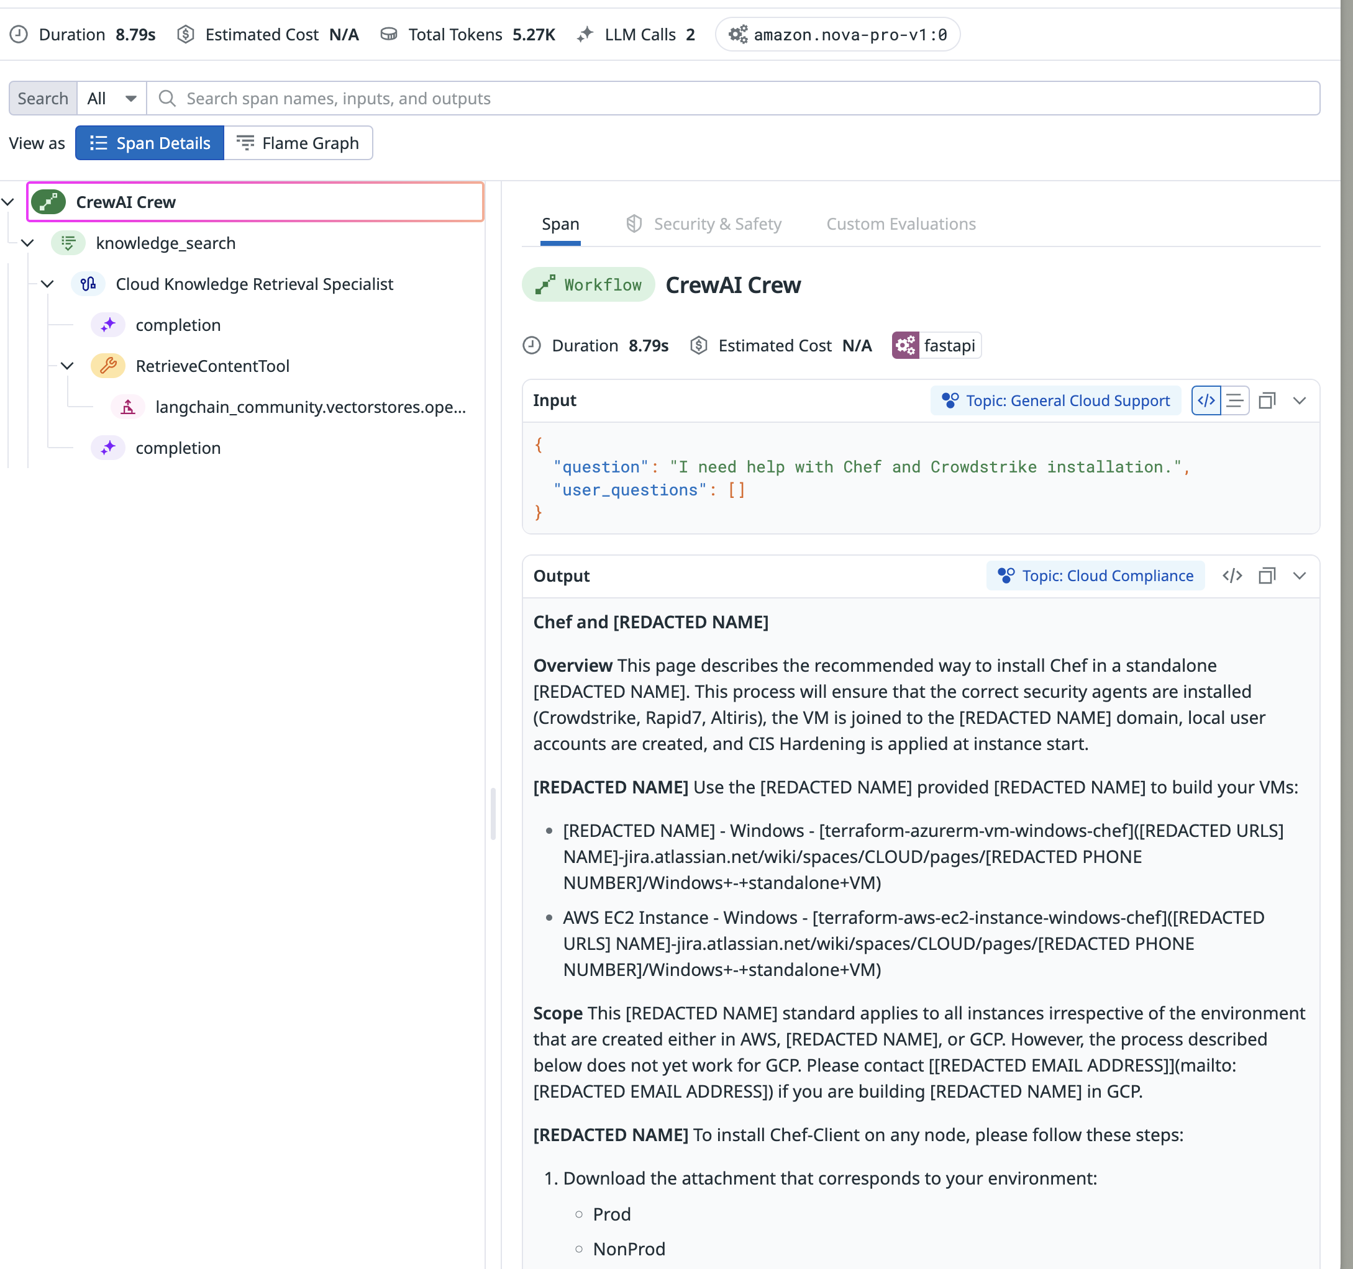
Latency Improvement from 1m to < 9s

Slide 13
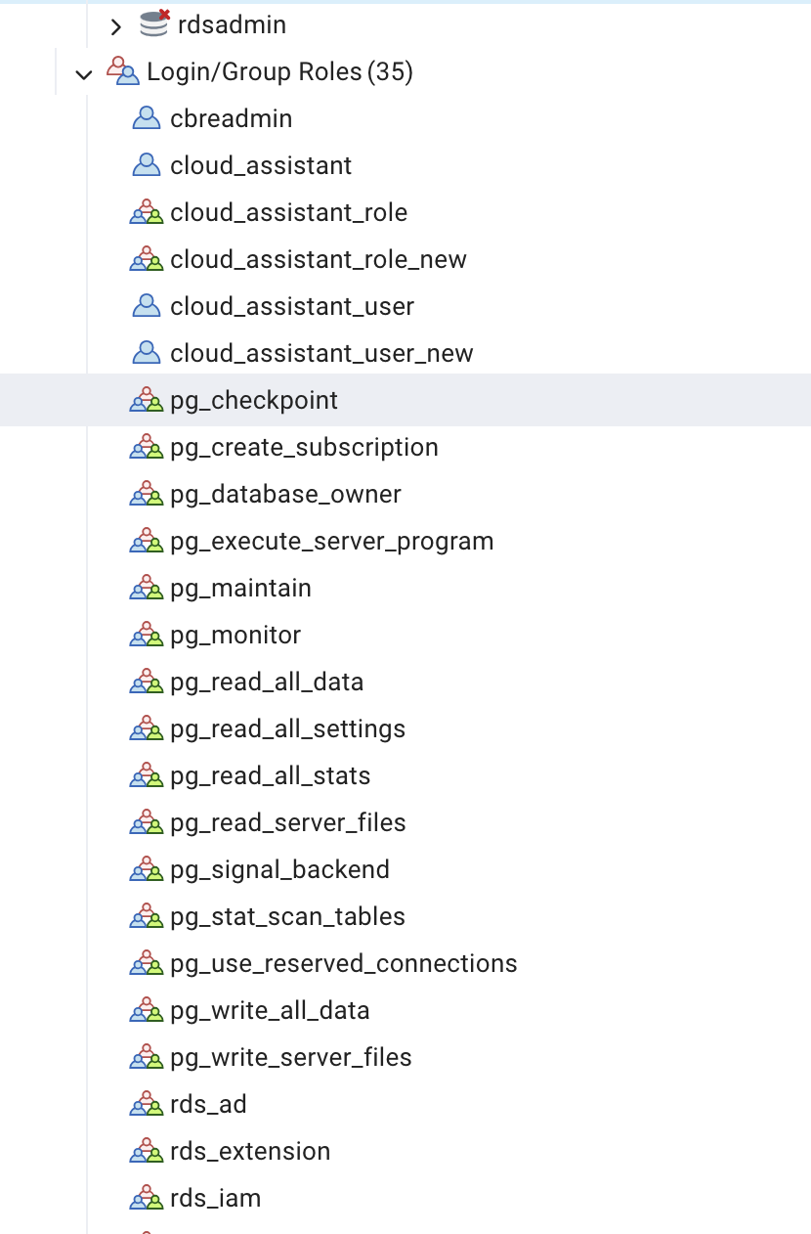
Creating user schema, roles and privileges for Rightsizing and Cloud assistant projects through PostgresSQL
2

Slide 14
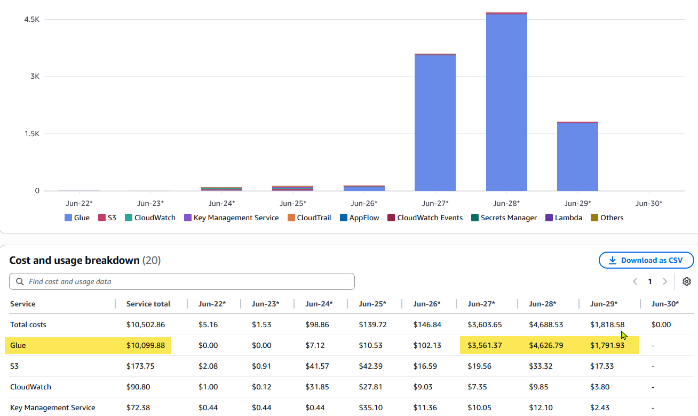
Agentic AI Anomaly Detection
3

Slide 15


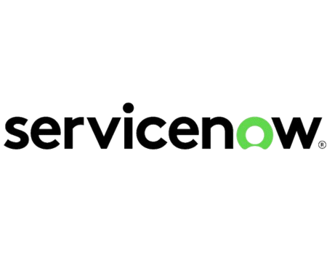





Data flow diagram | Agentic AI Anomaly Detection
Threshold Validator Agent
AWS Cost Anomaly Detection
Creates Servicenow Ticket
Fetch & Load Recommendations
Get Recommendations
Anomaly Intake Agent
ML Model to Identify False alarms
Notification & SN Ticket Agent
Datadog Agent for Logging
Azure Cost Anomaly
Postgres DB to save and update anomaly recommendations
Stakeholder Resolver Agent
Update Servicenow Ticket Status and User Feedback
Feedback Collection Agent
Send Email
Observability
Monitoring
Logging
Tracing
Clustering
Redacting

Slide 16
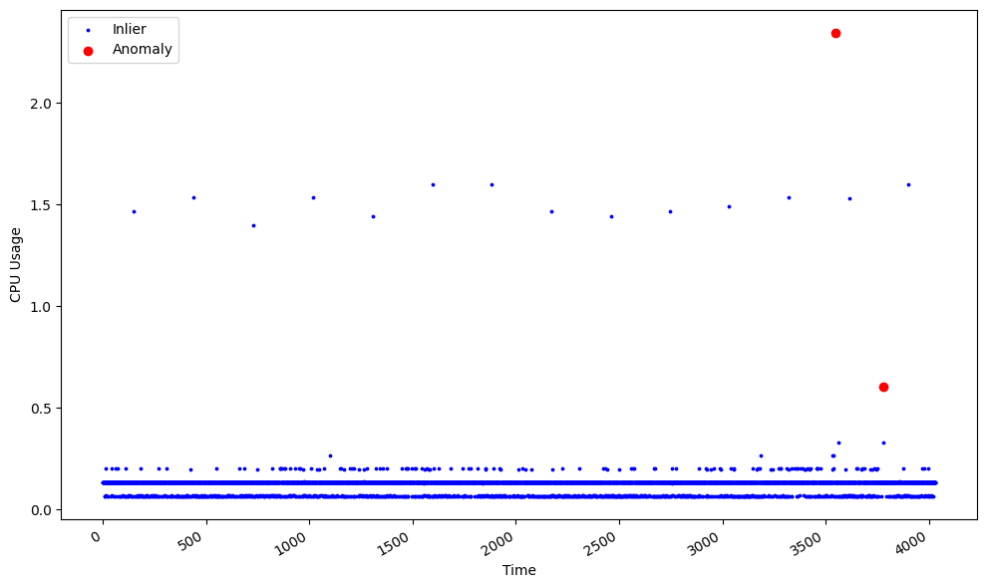
Steps
Design Agentic Architecture ✅
Write Agents ✅
Test with dummy data ✅
Develop a ML model to identify False alarms ✅
Work In Progress:
Pull data from cloud sources
Integrate with APIs
Monitoring & Tracking
Potential Developments:
Perform actions on user’s behalf post confirmation
Update Servicenow Ticket Status and User feedback

Slide 17

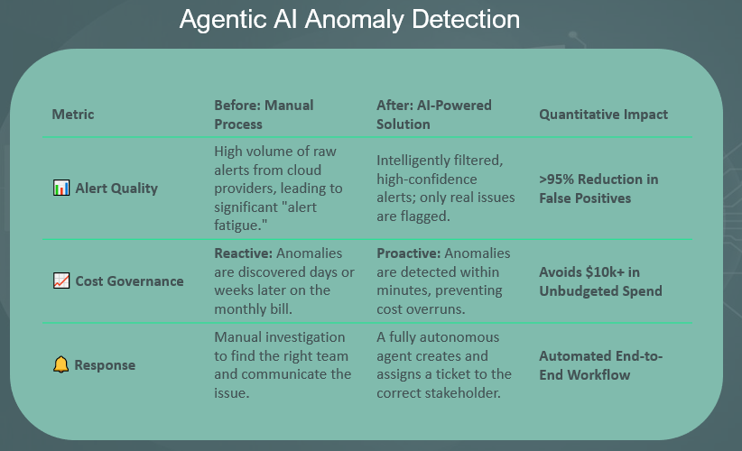
Impact
Intelligent Cloud Assistant
Metric | Before: | After: | Quantitative Impact
🧑‍💻 Datadog Integration | No monitoring, dashboards, and LLM Observability across services. | Automated integration with Datadog and enabled tracing to view in seconds. | >90% Reduction in Setup & Monitoring Time
🔐 Datadog Redaction | Sensitive PII data exposed in logs. | Log redaction logic ensures sensitive data is automatically masked before ingestion. | 100% Sensitive Data Protection
⚡ Latency Optimization | Average latency of 50s due to inefficient data pipelines. | Optimized pipeline and prompt tuning reduced latency to 6s. | ~88% Latency Reduction More user engagement and retention

Slide 18
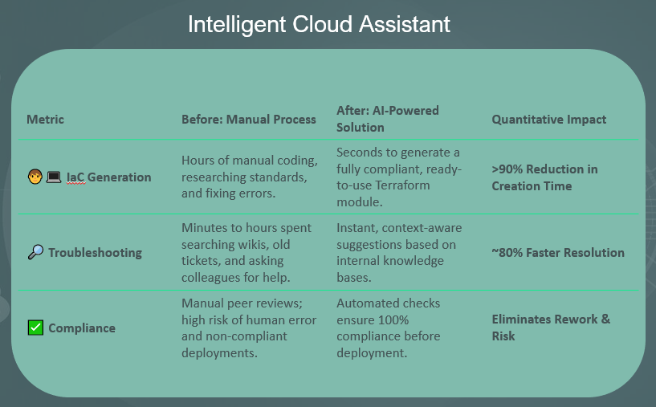
Impact
Agentic AI Anomaly Detection
Metric | Before: Manual Process | After: AI-Powered Solution | Quantitative Impact
📊 Alert Quality | High volume of raw alerts from cloud providers, leading to significant "alert fatigue." | Intelligently filtered, high-confidence alerts; only real issues are flagged. | >90% Reduction in False Positives
📈 Cost Governance | Reactive: Anomalies are discovered days or weeks later on the monthly bill. | Proactive: Anomalies are detected within minutes, preventing cost overruns. | Reduced annual Unbudgeted Spend
🔔 Response | Manual investigation to find the right team and communicate the issue. | A fully autonomous agent creates and assigns a ticket to the correct stakeholder. | Automated End-to-End Workflow

Slide 19


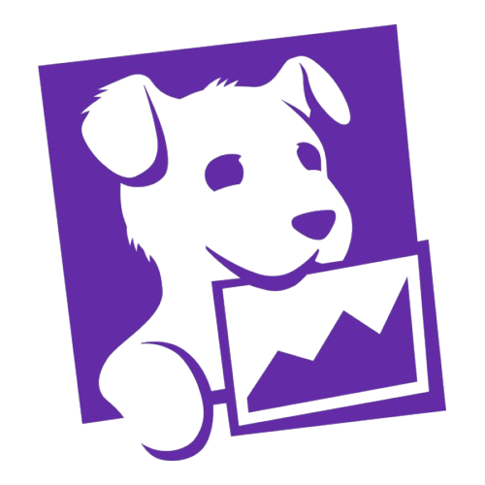
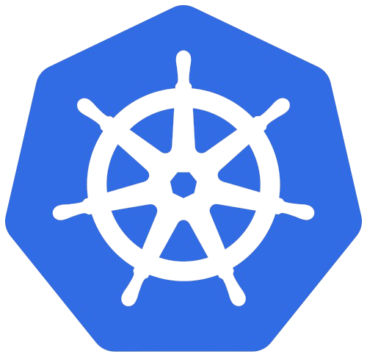
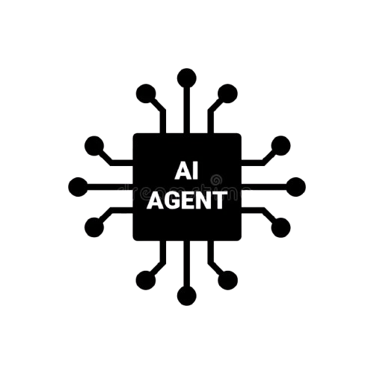
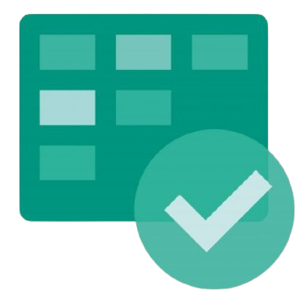

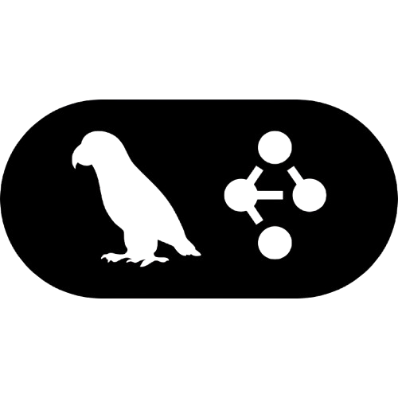




Growth
Notes:
I learned a lot in my time here at CBRE from soft skills to technical sklls and everything in between. Some key skills I learned while working here was working with multiple people across multiple teams and even across multiple timezones. Additionally, I got to work with some cool, modern technologies like SnowFlake and working with the Google Maps API which really taught me a lot on the technical side of things. Finally, the people at CBRE were definitely the highlight of my time here. I want to shoutout my team and the interns who really made everyday loads of fun. My team was very welcoming from the beginning and Ive had some fun adventures getting food with them after work and visiting their homes and families. I’ve also picked up another skill I wasn’t expecting to learn in the internship, that being ping pong, which my team loves to play. The internship program has had a bunch of fun events too and I loved going to volunteer at UTD and see the younger generations having fun learning computer science as well. Overall Ive had a great time here and thank you so much to everyone on my team and my fellow interns and a special thanks to my manager Phani and Hayley for always being there.

Slide 20
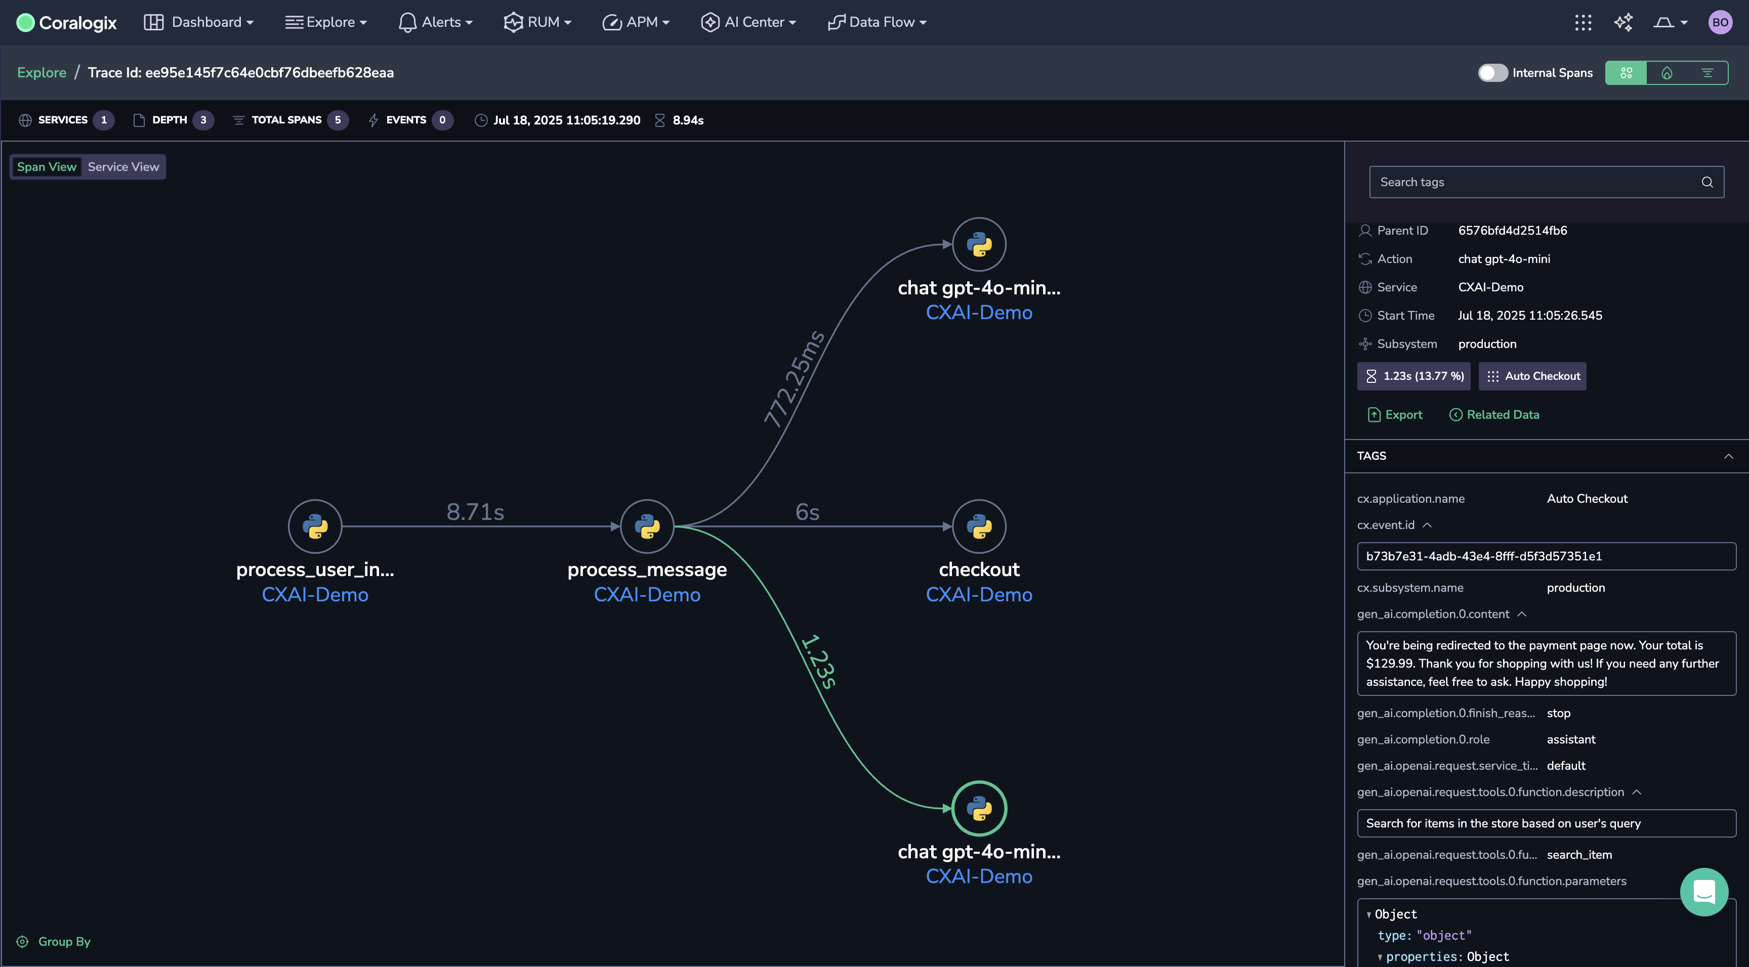
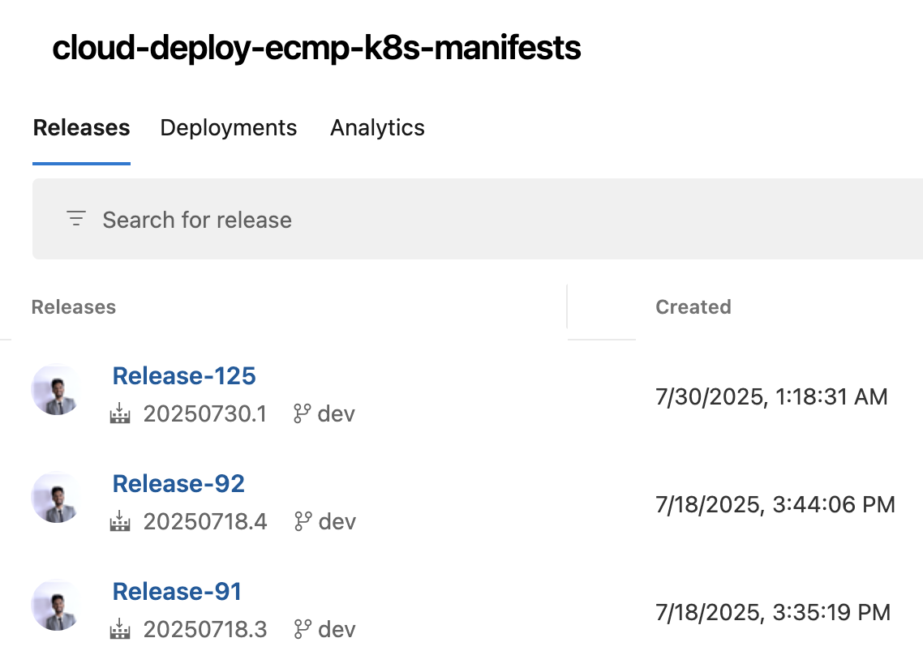
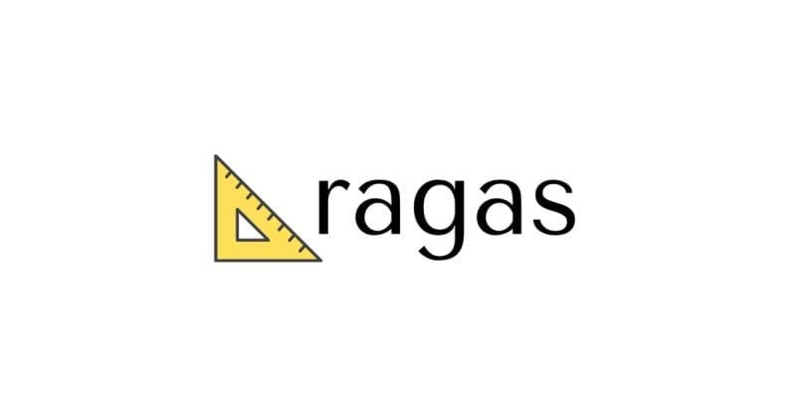
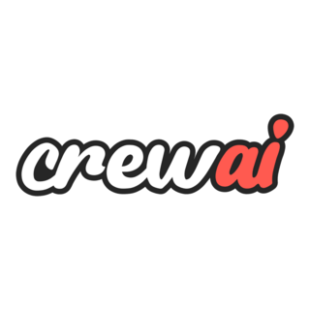

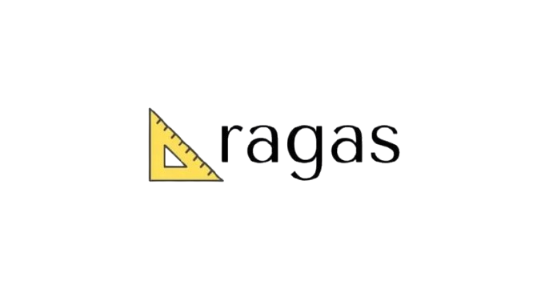
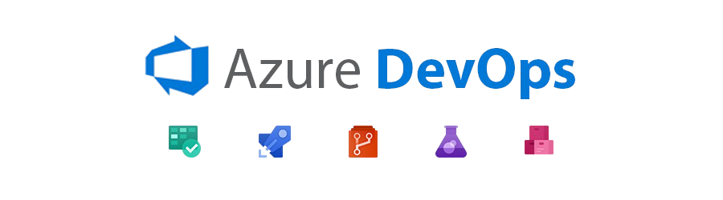
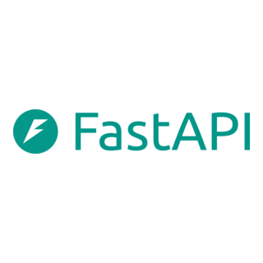
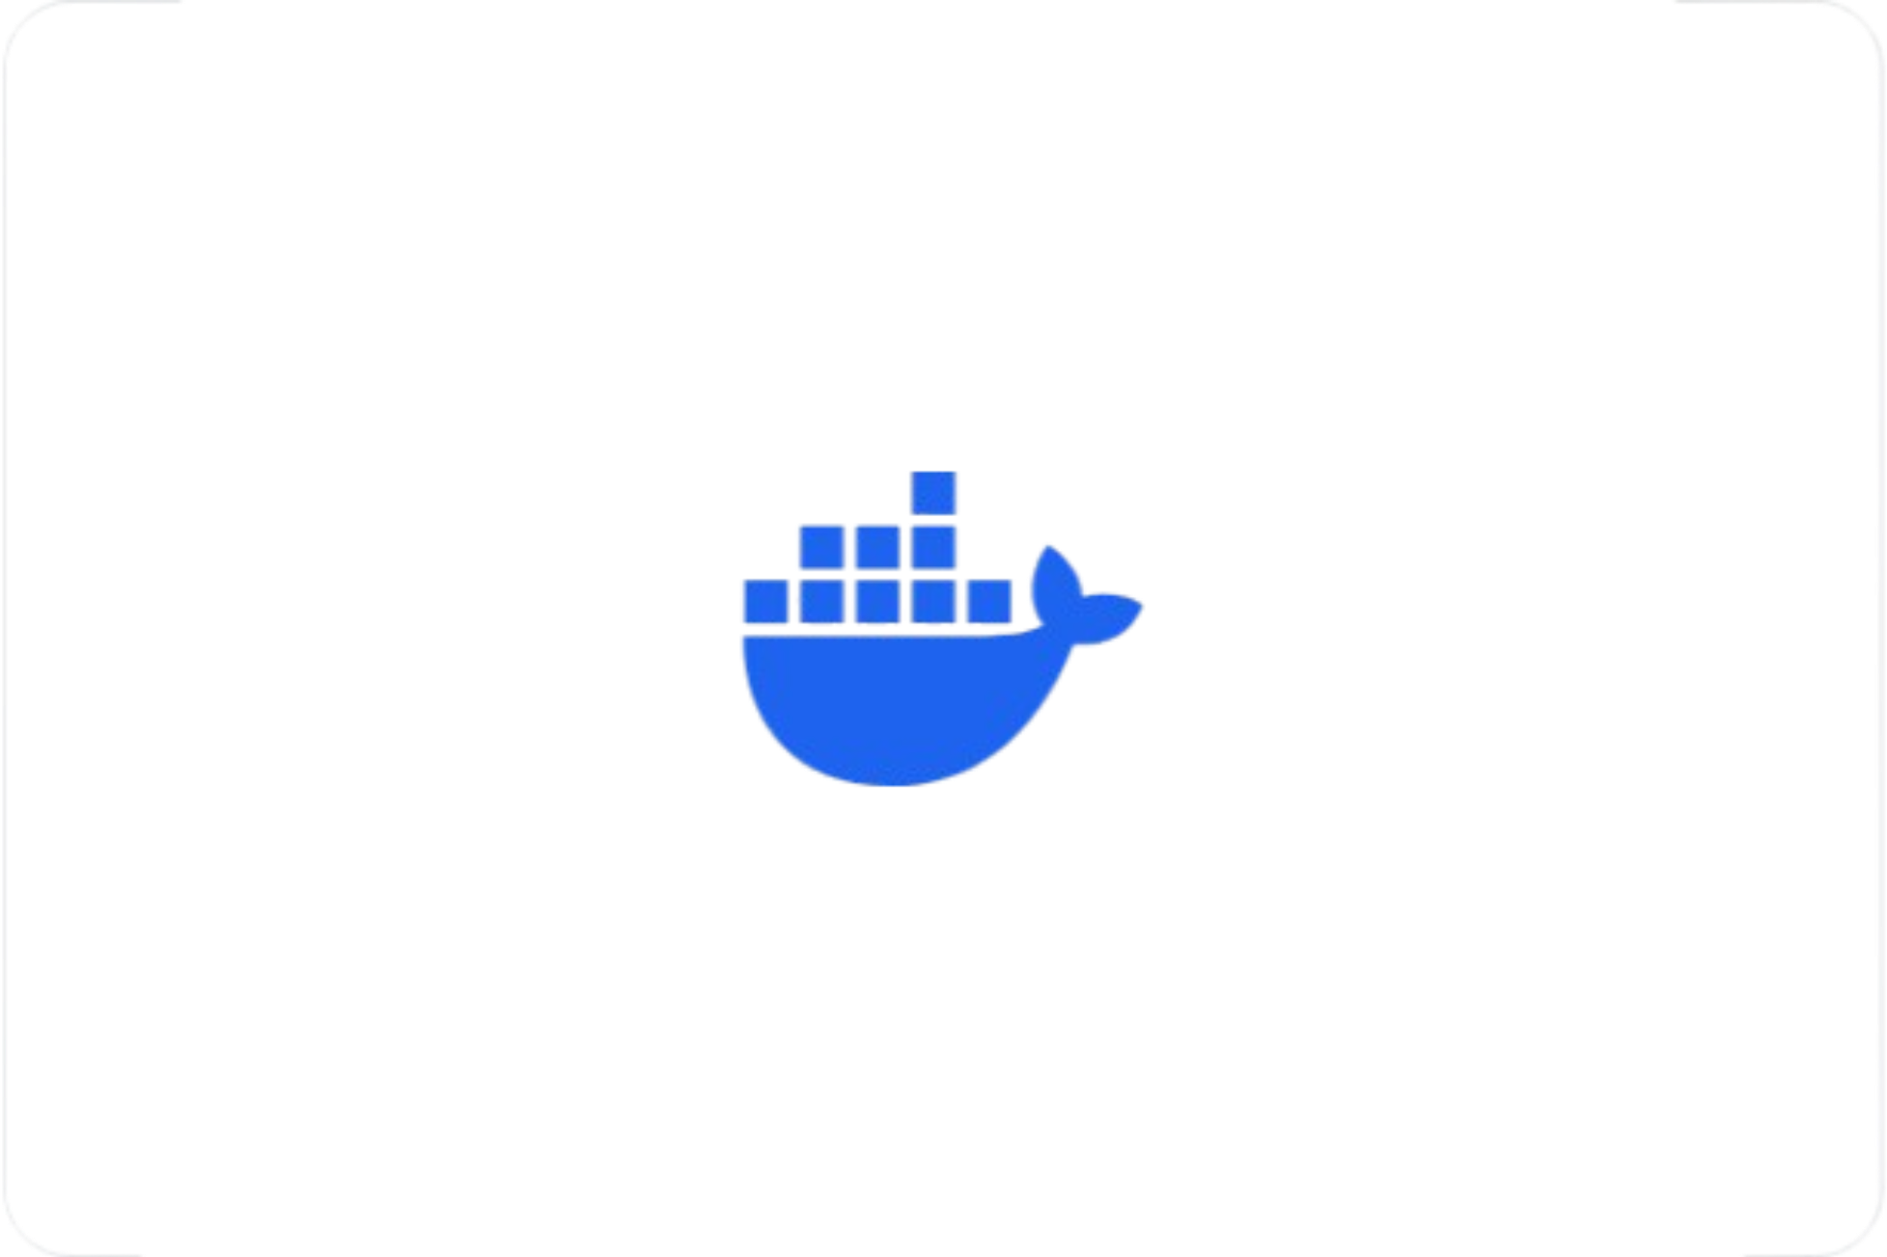





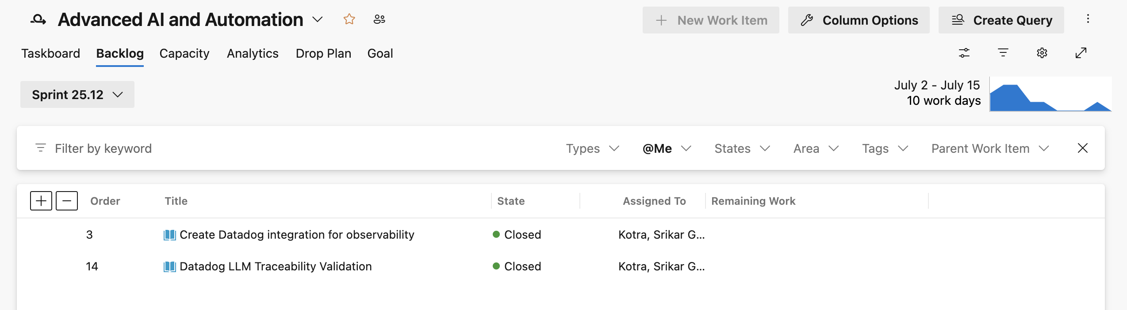
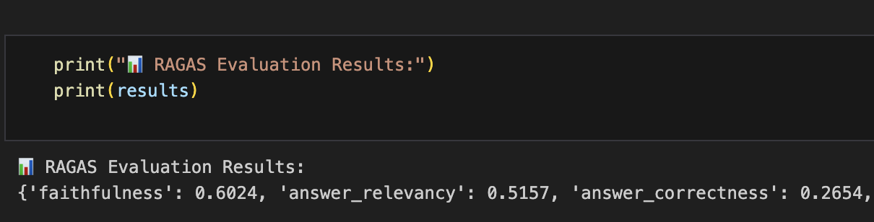
Technical Learning
Notes:
I learned a lot in my time here at CBRE from soft skills to technical sklls and everything in between. Some key skills I learned while working here was working with multiple people across multiple teams and even across multiple timezones. Additionally, I got to work with some cool, modern technologies like SnowFlake and working with the Google Maps API which really taught me a lot on the technical side of things. Finally, the people at CBRE were definitely the highlight of my time here. I want to shoutout my team and the interns who really made everyday loads of fun. My team was very welcoming from the beginning and Ive had some fun adventures getting food with them after work and visiting their homes and families. I’ve also picked up another skill I wasn’t expecting to learn in the internship, that being ping pong, which my team loves to play. The internship program has had a bunch of fun events too and I loved going to volunteer at UTD and see the younger generations having fun learning computer science as well. Overall Ive had a great time here and thank you so much to everyone on my team and my fellow interns and a special thanks to my manager Phani and Hayley for always being there.

Slide 21
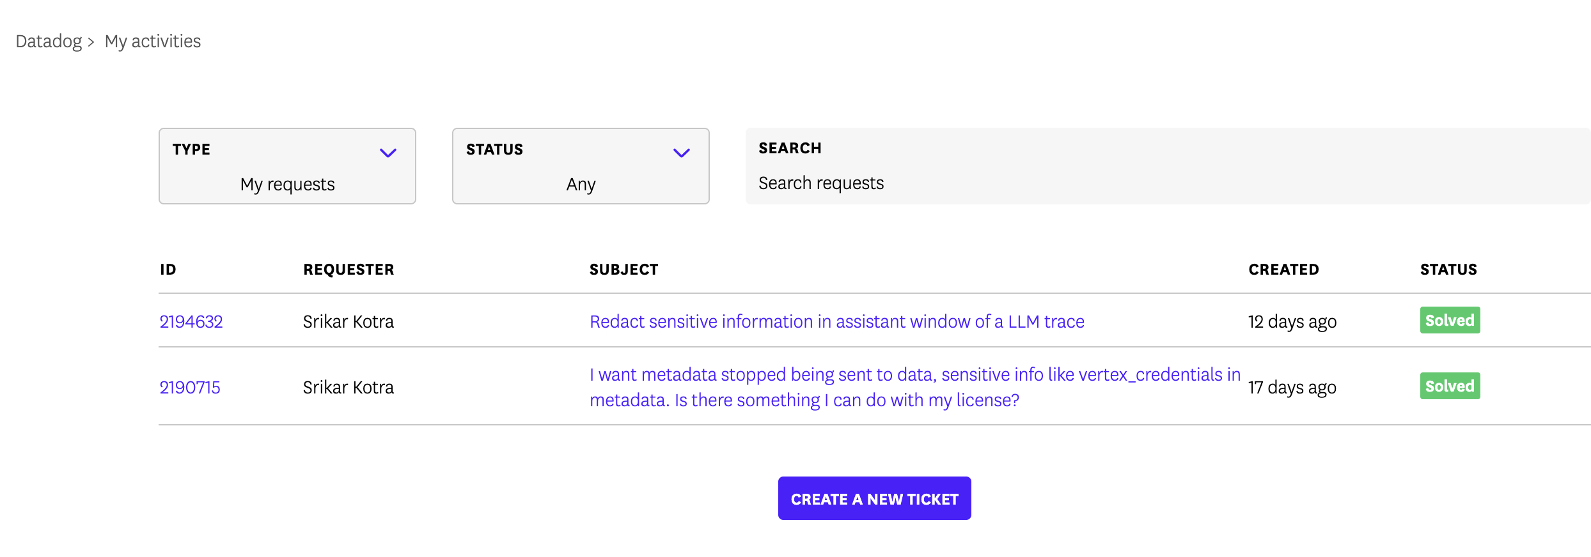
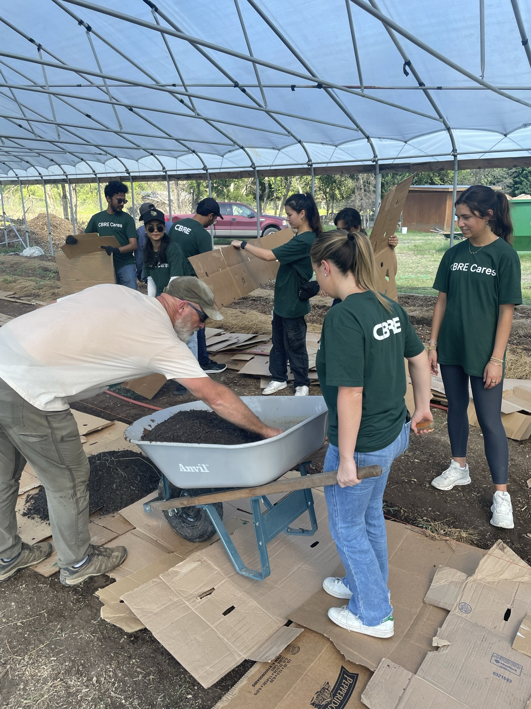
Roadmap
June 18,2025 Onboarding & Setup Gained access to tools, met team, understood project scope
June 30, 2025 Leadership Engagement Connected with leaders for guidance and review.
July 15, 2025 Issue Resolution Identified and fixed a critical Datadog bug.
July 30, 2025 Idea Sharing Presented suggestions and improvements in team meetings
July 07, 2025 Cross-Team Collaboration Worked with teams across UK and India on shared deliverables
July 24, 2025 Event Participation Table Tennis Tournament
D&T Intern Alumni Networking
Volunteering at Bonton Farms
June 25, 2025 Datadog Integration Understood workflows, began collaboration/ Collaborated with the Datadog team on observability tasks
Notes:
I learned a lot in my time here at CBRE from soft skills to technical sklls and everything in between. Some key skills I learned while working here was working with multiple people across multiple teams and even across multiple timezones. Additionally, I got to work with some cool, modern technologies like SnowFlake and working with the Google Maps API which really taught me a lot on the technical side of things. Finally, the people at CBRE were definitely the highlight of my time here. I want to shoutout my team and the interns who really made everyday loads of fun. My team was very welcoming from the beginning and Ive had some fun adventures getting food with them after work and visiting their homes and families. I’ve also picked up another skill I wasn’t expecting to learn in the internship, that being ping pong, which my team loves to play. The internship program has had a bunch of fun events too and I loved going to volunteer at UTD and see the younger generations having fun learning computer science as well. Overall Ive had a great time here and thank you so much to everyone on my team and my fellow interns and a special thanks to my manager Phani and Hayley for always being there.

Slide 22
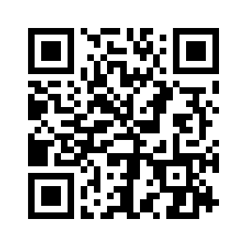
Thank you.
Contact Info
Tel. +1 945 274 8719
kotrasrikar@gmail.com
LinkedIn:
John Gideon
Giri Sripati
Thilak Jayachandran
Martin, David
Gaur, Pradeep Thambusamy, Charles
Pallapothu, Rajesh
Kadiyala, Pavitra
Chettupalli, Sai Praveen
Hayley Murphy

